Slide 1

Monocular depth estimation
201820894 유원균
새별의 파워포인트

Slide 2

목차
A table of contents
1
General insight
2
Supervised Network
3
Self supervised Network
ⓒSaebyeol Yu. Saebyeol’s PowerPoint

Slide 3

Part 1,
General Insight
How Do Neural Networks See Depth in Single Images?
(Dijk et al)

Slide 4



1.1
Pictorial cues of human depth estimation
Position in the image
Occlusion
Texture density
Apparent size of objects
Focus blur
Linear perspective

Slide 5
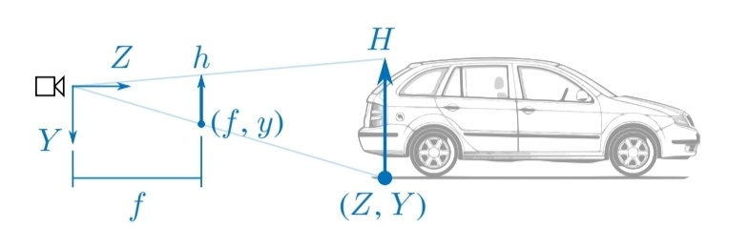
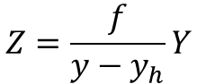
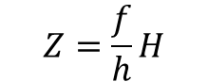
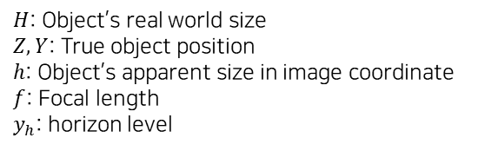
1.1
Pictorial cues of human depth estimation
vs
Position in the image
Apparent size of objects
$H$: Object’s real world size
$Z, Y$: True object position
$h$: Object’s apparent size in image coordinate
$f$: Focal length
$y_{h}$: horizon level
$$Z=\frac{f}{y−y_{h}}Y$$
$$Z=\frac{f}{h}H$$

Slide 6



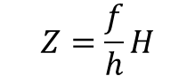
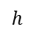
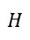
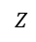
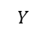
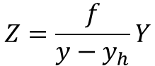

1.2
How to measure depth?
$H$: Object’s real world size
$Z, Y$: True object position
$h$: Object’s apparent size in image coordinate
$f$: Focal length
$y_{h}$: horizon level
$$Z=\frac{f}{y−y_{h}}Y$$
$$Z=\frac{f}{h}H$$
Assume pitch angle relative to horizaon is small.
(Camera angle is almost parallel to horizon)
$$H$$
$$h$$
$$Y$$
$$y$$
$$Z$$
$$y_{h}:\text{Camera} \text{pitch}$$
Real World Coordinate
Pixel Image Coordinate

Slide 7
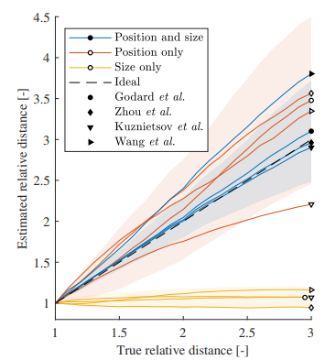
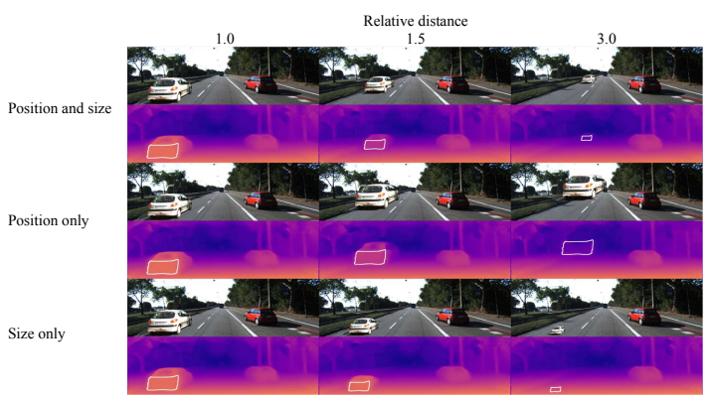
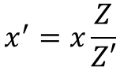
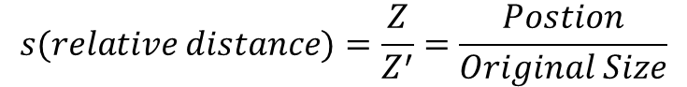
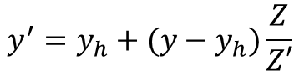
1.3
Influence of Vertical position and Apparent Size
$$s(relative distance)=\frac{Z}{Z^{′}}=\frac{Postion}{Original Size}$$
$$x^{′}=x\frac{Z}{Z′}$$
$$y^{′}=y_{h}+(y−y_{h})\frac{Z}{Z′}$$
Neural network rely primarily on the vertical position of objects rather than their apparent size.

Slide 8
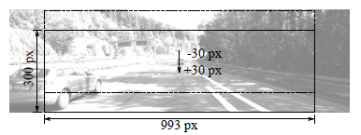
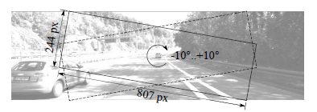
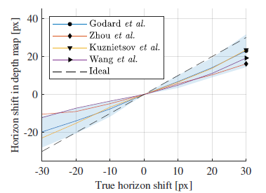
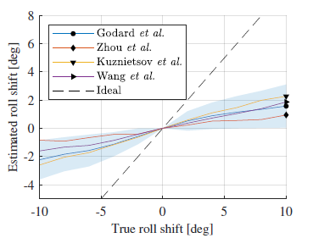
1.4
Influence of Image Position and Camera Roll Angle

Slide 9
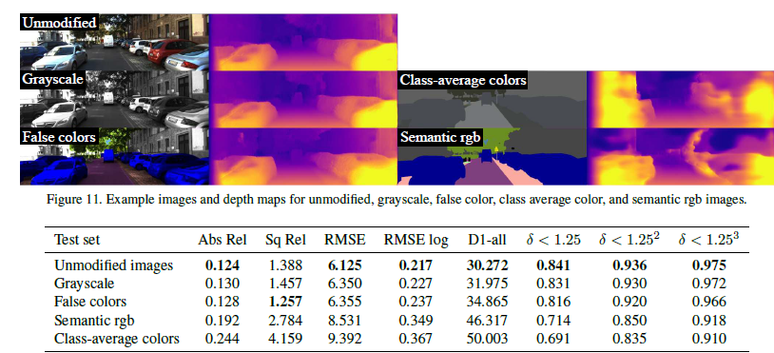
1.5
Influence of Camera Texture
{
}
Exact color of obstacles does not strongly affect the depth estimate
Texture affects the depth estimate

Slide 10
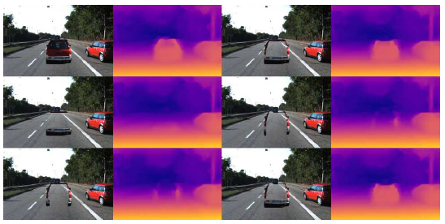
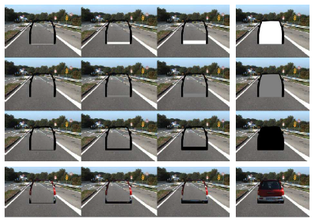
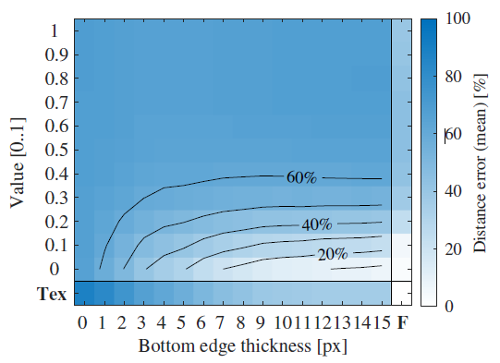
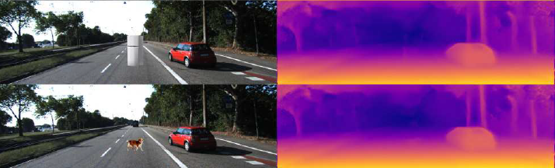

1.6
Influence of Shape and Contrast
Bottom edge thickness and value are important!

Slide 11

Part 2,
Supervised Network

Slide 12
2.1
Related works
Depth Map Prediction from a Single
Image using a Multi-Scale Deep Network.
(Eigen et al, 2012)
AdaBins: Depth Estimation Using Adaptive Bins
(Bhat et al, 2021)
Classification
problem
Regression problem
Adaptive Bins
Deep Ordinal Regression Network
for Monocular Depth Estimation.
(Fu et al, 2018)

Slide 13
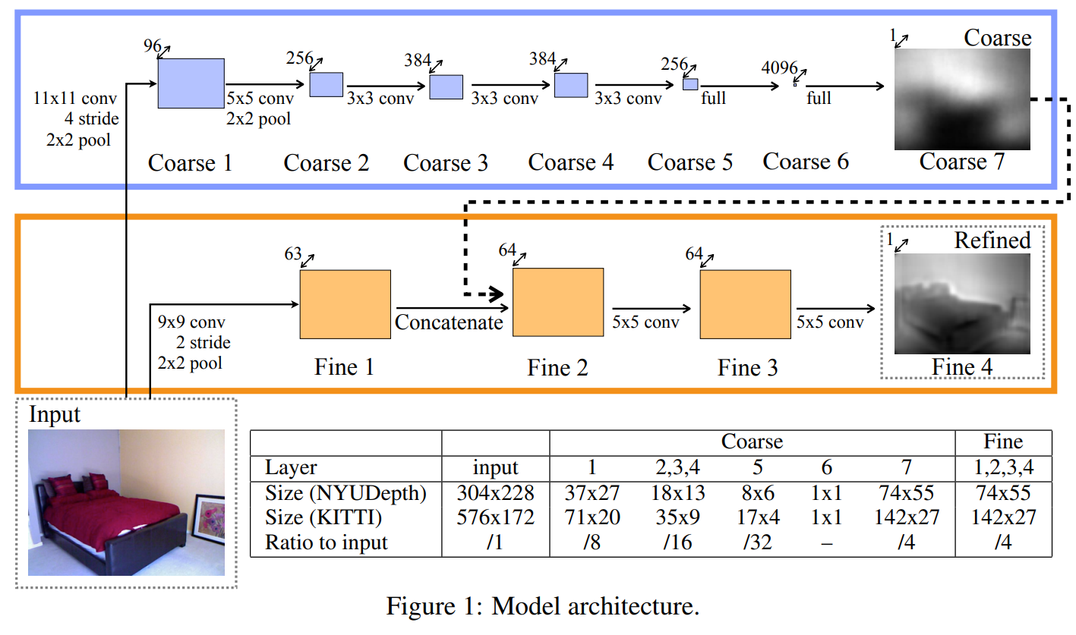
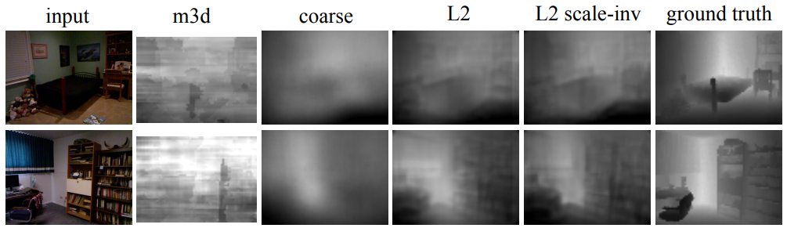
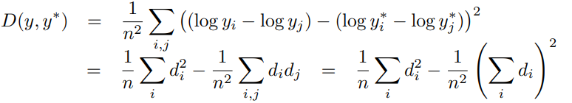
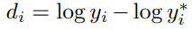
2.2
Depth Map Prediction form a Single Image Using a Multi-Scale Deep Network
Global Perspective
Local Perspective
Scale Invariant Loss
Consistency feedback term
General Log Scale MSE

Slide 14
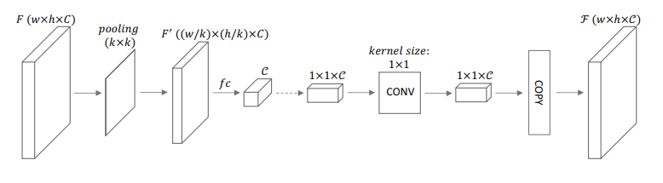
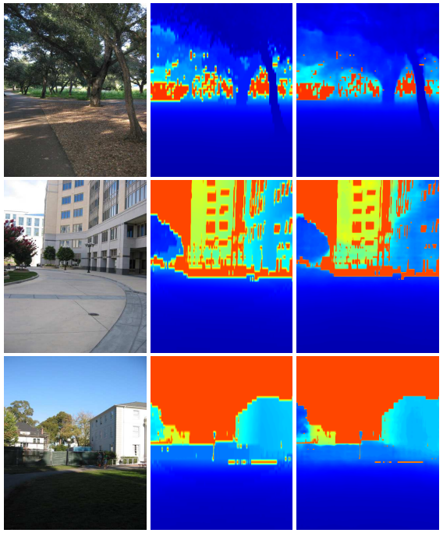
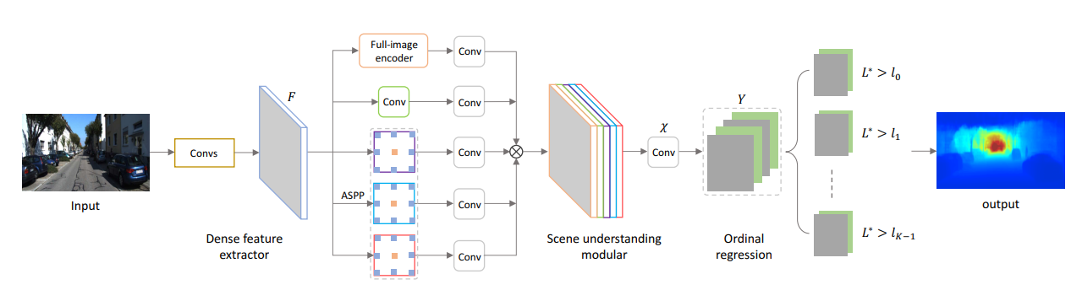
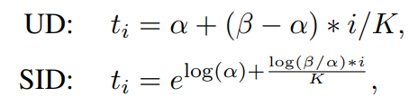
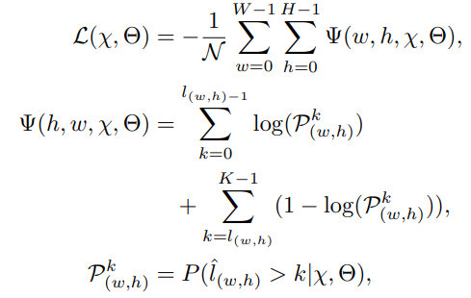
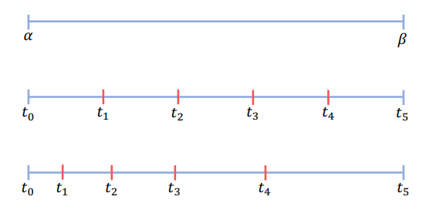
2.2
Deep Ordinal Regression Network for Monocular Depth Estimation
1x1 conv:Learn complex cross channel interactions.
ASPP: Extract features from multiple large receptive fields
Spacing-Increasing Discretization
Ordinal Regression
Real Depth
k | 1 | 2 | 3 | 4 | 5 | 6 | 7 | 8 | 9
High prediction | 1 | 1 | 1 | 1 | 1 | 1 | 1 | 0 | 0
Low prediction | 1 | 1 | 0 | 0 | 0 | 0 | 1 | 1 | 1
Estimated Depth
Error

Slide 15
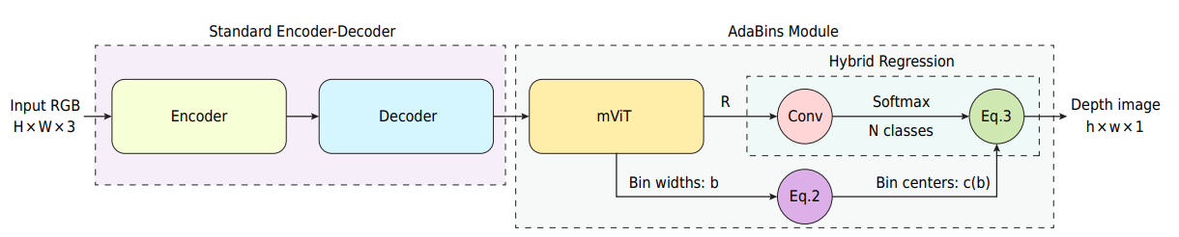
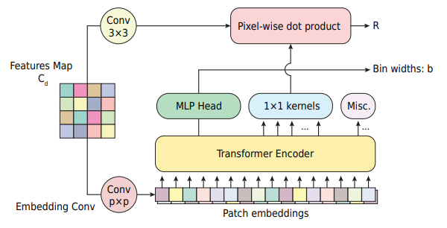
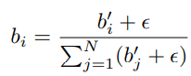
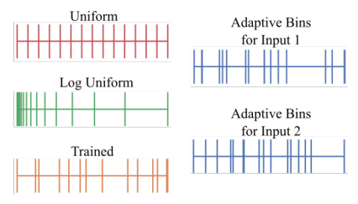
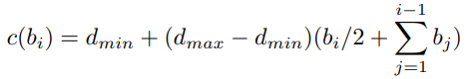
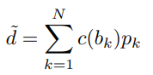
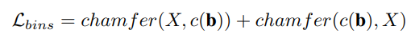
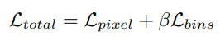
2.3
AdaBins: Depth Estimation Using Adaptive Bins
Two Main differences:
Using Vit
2. Adaptive Bins
Depth Bin Centers:
Final Depth Value:
Bin center density loss:
Final Loss:

Slide 16

Part 3,
Self Supervised Network

Slide 17
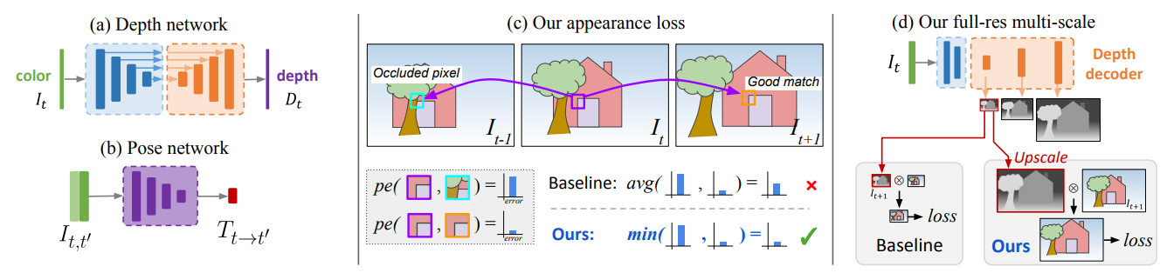
3.1
Monodepth v2: Pipeline
Depth network(encoder-decoder): Fully convolutional U-net
Pose network: Assume stationary scene and moving camera>>Network to estimate transform matrix between two scenes.
Appearance loss: Per-pixel minimum reprojection(next page)
Full res multi-scale: Compute loss after upsampling low resolution image

Slide 18
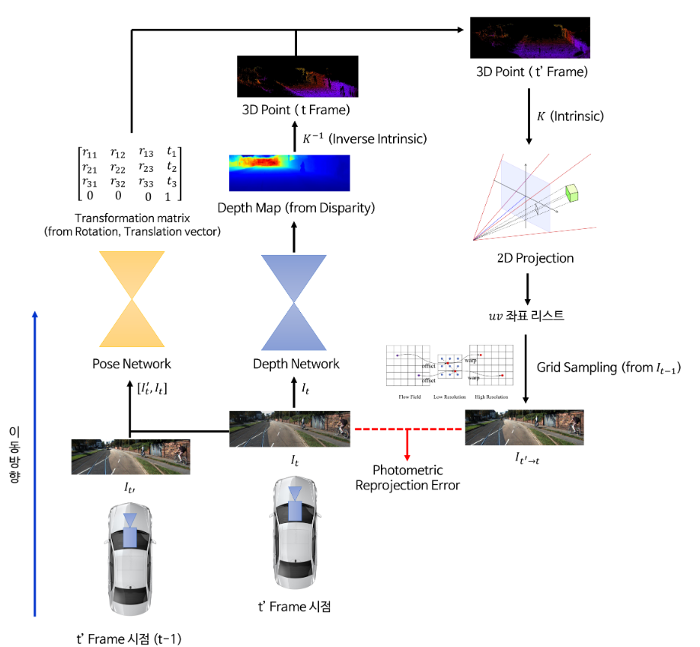
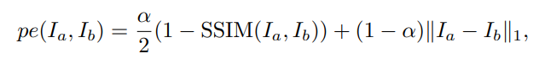
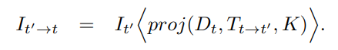
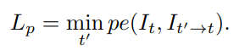
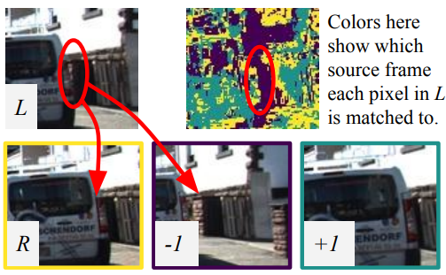
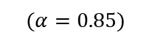
3.2
Monodepth v2: Loss
$$(α=0.85)$$
내용 입력
-Minimum photometric reconstruction error
: Way to handle disocclusion problem
https://gaussian37.github.io/vision-concept-ssim/

Slide 19
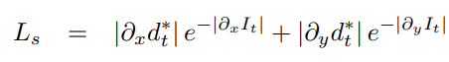


3.2
Monodepth v2: Loss
($d_{t}^{∗}=d_{t}/\overline{d_{t}})$
-Edge smoothness error
: Reflect more loss when small image difference but large depth difference.

Slide 20



3.3
Monodepth v2: Auto Masking Stationary Pixels
$$(μ:per pixel mask)$$
Self-supervised monocular training operates under the assumptions of a moving camera and static scene.
How to find auto-masking method that filters out pixels which do not change appearance form one frame to the next in the sequence?
Do not use stationary pixel on training.

